Slide 1
Declarative Programming Paradigm: Logic Programming
Module 4

Slide 2
Logic Programming
•Axiom are written in a standard form known as Horn clauses
–A Horn clause consists of a consequent (head H) and a body (terms Bi)
H ➨ B1, B2,…, Bn
–Semantics: when all Bi are true, we can deduce that H is true

Slide 3
Prolog
SWI-Prolog has been under continuous development since 1987.
Its main author is Jan Wielemaker.
The name SWI is derived from
Sociaal-Wetenschappelijke Informatica ("Social Science
Informatics"), the former name of the group at the University of
Amsterdam, where Wielemaker is employed.
Main applications:
–Artificial intelligence: expert systems, natural language processing,...
–Databases: query languages, data mining,…
–Mathematics: theorem proving, symbolic packages,…

Slide 4
SWI Prolog
SWI-Prolog offers a comprehensive FREE SOFTWARE
Prolog environment.Development environment
https://www.swi-prolog.org/
Download
https://www.swi-prolog.org/Download.html OR
http://www.swi-prolog.org/download/stable
Online
https://swish.swi-prolog.org/
LINUX versions are also available.

Slide 5
•The program, sometimes called Database is a text file (*.pl) that contain the facts and rules. It contains all the relations needed to define the problem.
•When you launch a program you are in query mode represented by the ? – prompt. In query mode you ask questions about the relations described in the program.
•When Prolog is launched the ?- should appear meaning you are in query mode. In SWI-Prolog you can load a program by typing the command [file]. when the file containing your program is file.pl. When you have done this you can use all the facts and rules that are contained in the program. OR use Query Window

Slide 6
Prolog
PROgramming LOGic
Prolog is a declarative language
A program is a collection of axioms from which theorems can be proven.
–Rather than describing how to compute a solution, a program consists of a data base of facts and logical relationships (rules).
–Rather then running a program to obtain a solution, the user asks a question. When asked a question, the run time system searches through the data base of facts and rules to determine (by logical deduction) the answer.

Slide 7
A PROLOG program consists of:
Declaration of the facts of the relations involved.
Declaration of rules concerning relations
Formulation of questions to be answered.

Slide 8
Facts
Facts are statements about what is true about a problem, instead of instructions how to accomplish the solution.
The Prolog system uses the facts to work out how to accomplish the solution by searching through the space of possible solutions.
It is defined by an identifier followed by an n-tuple of constants.
A relation identifier is referred to as a predicate
When a tuple of values is in a relation we say the tuple satisfies the predicate

Slide 9
Syntax for fact declaration
Names of relationship and objects must begin with a lowercase letter.
Relationship is written first (typically the predicate of the sentence).
Objects are written separated by commas and are enclosed by a pair of round brackets.
The full stop character ‘.’ must come at the end of a fact.

Slide 10
Predicate Interpretation
valuable(gold) .
owns(john,gold) .
father(john,mary) .
gives (john,book,mary) .
Gold is valuable.
John owns gold.
John is the father of Mary
John gives the book to Mary

Slide 11
Rules
Specifies under what conditions a tuple of values satisfies a predicate.
The basic building block of a rule is called an atom
Atom :- Atom1, ..., Atomn
If each of Atom1,...,Atomn is true, then Atom is also true.

Slide 12
Rules specify:
If-then conditions
I use an umbrella if there is a rain
use(i, umbrella) :- occur(rain).
Generalizations
All men are mortal
mortal(X) :- man(X).
Definitions
An animal is a bird if it has feathers
bird(X) :- animal(X), has_feather(X).

Slide 13
Queries
Ground Query
edge(a,b)
This query is called a ground query because it consists only of value identifiers as parameters to the predicate.
a ground query is posed we expect a true/false answer.
Non Ground Query
They have variables as parameters
tedge(a,X)

Slide 14
Syntax of rule
<head>:- <body>
Read ‘:-’ as ‘if’.
likes(john,X) :- likes(X,cricket).
“John likes X if X likes cricket”.
i.e., “John likes anyone who likes cricket”.
Rules always end with ‘.’

Slide 15
Examples
Facts: ()
likes(john,mary).
likes(john,X). % Variables begin with capital
Queries
?- likes(X,Y).
X=john, Y=Mary. % hit “;” for more or Next
?- likes(X,X).
X=john.

Slide 16
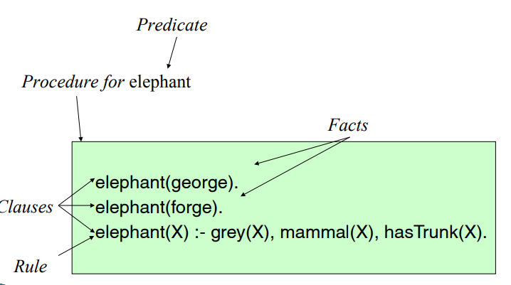
Example

Slide 17
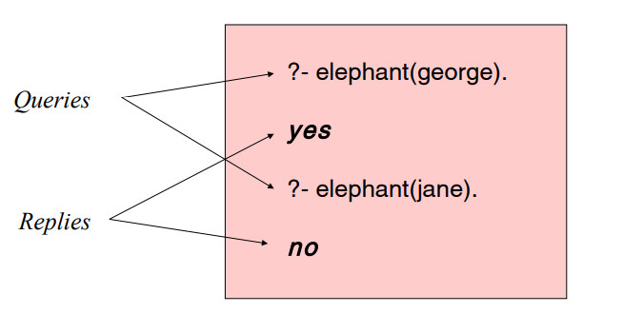

Slide 18
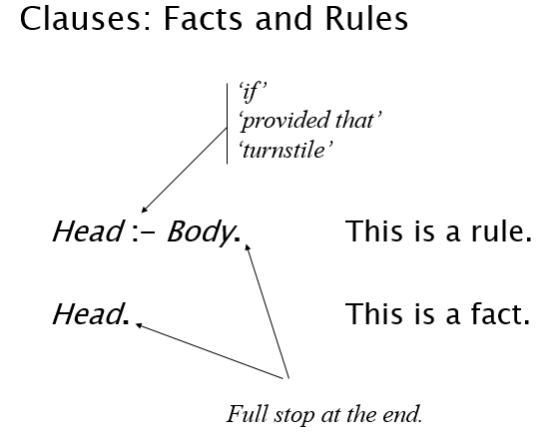
Notes:
http://www.cs.nuim.ie/~jpower/Courses/Previous/PROLOG/

Slide 19
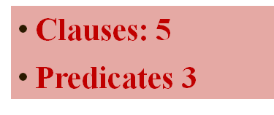
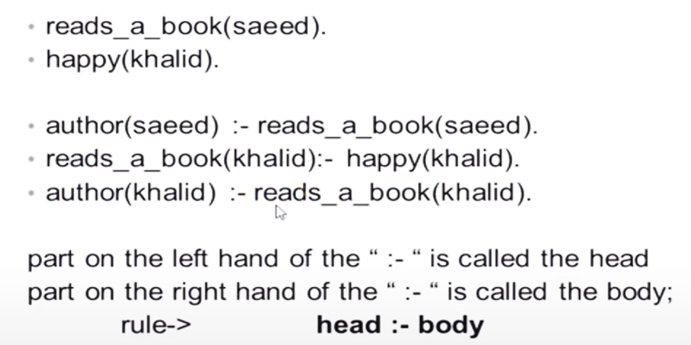
Knowledge base
•may have facts and rules
–If the body of the rule is true then head implies true

Slide 20
Question Answering in presence of rules
Facts
male (ram).
male (shyam).
female (sita).
female (gita).
parents (shyam, gita, ram).
parents (sita, gita, ram).
Rule:
sister_of (X,Y):- female (X), parents (X, M, F),parents (Y, M, F).
X is a sister of Y is X is a female and X and Y have same parents

Slide 21
Conjunction and Disjunction
Rules can be deduced using conjunction and / or disjuction
Conjunction of predicates is represented as a sequence of structures, separated by commas”,”.
It is referred as “AND”
sister_of (X,Y):- female (X), parents (X, M, F) ,parents(Y,M,F).
Disjunction of predicates is represented as a sequence of structures, separated by semicolon”;”.
It is referred as “OR”
friend(ram,shyam):- friend(shyam,sita);friend(shyam,mohan).

Slide 22
Terms
Prolog is a typeless language
Prolog has one type
Every Prolog data structure is a term
Every term is one of:
A constant , which is either an atom or a number (integer or float)
A variable
A compound term

Slide 23
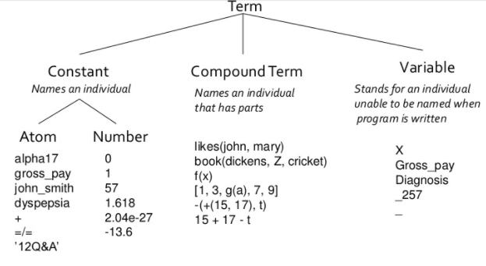

Slide 24
Atom
An atom is:
Anything enclosed in single quotes (e.g. 'Whatever you like').
Any sequence of characters, numbers and/or the underscore character which is preceded by a lower case character (e.g. this_IS_an_atom).
Any continuous sequence of the symbols: +, -, *, /, \, ^, >, <, =, ', :, ., ?, @, #, $, &. (e.g. ***+***+@).
Any of the special atoms: [], {}, ;, !.

Slide 25
The Prolog built-in predicate atom/1 will tell you if a given term is or isn't an atom. It gives the following behaviour:
| ?- atom(foo).
true
| ?- atom(Foo).
false
| ?- atom('Foo').
true
| ?- atom([]).
true

Slide 26
Number
A number can be either:
An integer (e.g. 99).
A floating point number (e.g. 99.91).
The built-in predicate integer/1 succeeds if its argument is an integer. The built-in predicate real/1 succeeds if its argument is a real number.
These give the following behaviour:
?- integer(9).
true
?- integer(99.9).
false

Slide 27
?- real(99.9).
true
?- real(9).
false
?- number(9).
true
?- number(99.9).
true
?- number(foo).
false
?- number(Foo).
false

Slide 28
Variables
A variable is:
Any sequence of characters, numbers and/or the underscore character which is preceded by an upper case character (e.g. This_IS_a_variable).
Any sequence of characters, numbers and/or the underscore character which is preceded by an underscore (e.g. _this_IS_a_variable).
An underscore character by itself (e.g. _). The underscore character is referred to as the anonymous variable because it cannot be referenced by its name in other parts of the clause.

Slide 29
The Prolog built-in predicate var/1 will tell you if a given term is or isn't a variable. It gives the following behaviour:
?- var(Foo).
yes
?- var(_).
yes
?- var(foo).
no

Slide 30
Compound Terms
Structures (like function, applications)
<identifier>(Term1, ..., Termk)
date(1, may, 1983)
point(X, Y, Z)
note that the definition is recursive. So each term can itself be a structure
date(+(0,1), may, +(1900,-(183,100)))
Structures can be represented as a tree

Slide 31
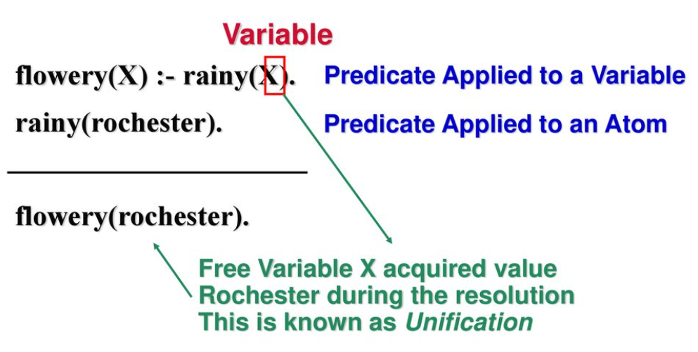

Slide 32
Anonymous Variables
wealthy(employee(_, _, _, Salary)) :- Salary >= 100000.
Each is a separate anonymous variable; it means we don’t care about its value
?- wealthy(employee(1234,’Jones’, ’James’, 100000)).
Yes
?- wealthy(employee(5678,’Smith’, ’Sam’, 20000)).
No

Slide 33
Prolog uses two types of comments:
Line comments go from the “%” symbol to the end of the line
% This is a comment A An Introduction to Prolog
Multiline comments begin with a “/*” and end with a “*/”
/* this is a comment */

Slide 34
Resolution
Prolog execution is based on the principle of resolution
If C₁ and C₂ are Horn clauses and the head of C₁ matches one of the terms in the body of C₂, then we can replace the term in C₂ with the body of C₁
For example,
C₁: likes(sam,Food) :- indian(Food), mild(Food).
C₂: indian(dahl).
C₃: mild(dahl).
We can replace the first and the second terms in C₁ by C₂ and C₃ using the principle of resolution (after instantiating variable Food to dahl)
Therefore, likes(sam, dahl) can be proved

Slide 35
Unification
Questions based on facts are answered by matching
Unification is the name given to the way Prolog does its matching.
Two facts match if their predicates are same (spelt the same way) and the arguments each are same.
If matched, prolog answers true, else false.
false does not mean falsity . This means falset provable from the given facts.

Slide 36
Rule 1: Term1 and Term2 are constants → They unify iff they are the same atom or number
Eg:
bing = bong.
2 = 2.
‘joe’ = joe.
‘2’ = 2.

Slide 37
Rule 2: Either Term1 or Term2 is a variable → The variable is instantiated to the value of the other term, whatever type of term that may be, and the terms unify
Eg:
joe = X.
X =joe .

Slide 38
Rule 3: 3. Term1 and Term2 are complex terms → They unify iff:
(a) Their functors( predicate) and arities match
(b) Their corresponding arguments unify
(c) Their variable instantiations are compatible (X cannot equal joe and mary at the same time)
Eg:
ancestor(french(jean), B) = ancestor(A, irish(joe)).
likes(X, X) = likes(joe, pizza).
J = joe, J = john.

Slide 39
example
takes(jane_doe, his201).
takes(jane_doe, cs254).
takes(ajit_chandra, art302).
takes(ajit_chandra, cs254).
classmates(X, Y) :- takes(X, Z), takes(Y, Z).
Let X be jane_doe and Z be cs254
replace the ﬁrst term on the right-hand side of the last clause with the (empty) body of the second clause, yielding the new rule
classmates(jane_doe, Y) :- takes(Y, cs254).

Slide 40
In other words,
Y is a classmate of jane_doe if Y takes cs254.
The pattern-matching process used to associate X with jane_doe and Z with cs254 is known as uniﬁcation.
Variables that are given values as a result of uniﬁcation are said to be instantiated.

Slide 41
takes(jane_doe, his201).
takes(jane_doe, cs254).
takes(ajit_chandra, art302).
takes(ajit_chandra, cs254).
classmates(X, Y) :- takes(X, Z), takes(Y, Z).
Query/Goal
?- classmates(jane_doe, Y).
Y = jane_doe
Y = jane_doe
Y = ajit_chandra unifying to itself !!!

Slide 42
Again, summarizing the uniﬁcation rules for Prolog are as follows.
A constant uniﬁes only with itself.
Two structures unify if and only if they have the same predicate
(functor) and the same number of arguments, and the corresponding
arguments unify recursively.
A variable uniﬁes with anything.
If the other thing has a value, then the variable is instantiated. If the other thing is an uninstantiated variable, then the two variables are associated in such a way that if either is given a value later, that value will be shared by both

Slide 43
TRY
?- mia = mia.
yes
?- mia = vincent.
no
?- mia = X.
X=mia
Yes
?-X=mia, X=vincent.
no

Slide 44
?- k(s(g),Y) = k(X,t(k)).
X=s(g)
Y=t(k)
yes
?- k(s(g),t(k)) = k(X,t(Y)).
X=s(g)
Y=k
Yes
?- loves(X,X) = loves(marsellus,mia).
no

Slide 45
?- father(X) = X.
X=father(father(father(…))))
yes
?-

Slide 46
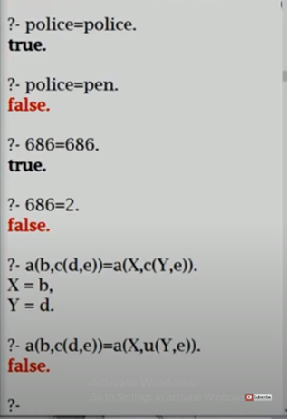
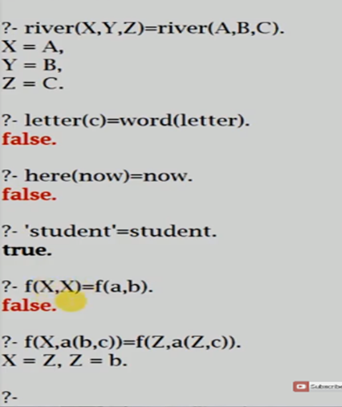

Slide 47
vertical( line(point(X,Y), point(X,Z))).
horizontal( line(point(X,Y), point(Z,Y))).
?- vertical(line(point(1,1),point(1,3))).
yes
?- vertical(line(point(1,1),point(3,2))).
no
?- horizontal(line(point(1,1),point(1,Y))).
Y = 1;
?- horizontal(line(point(2,3),Point)).
Point = point(_554,3);
no
?-

Slide 48
TRY
takes(jane_doe, his201).
takes(jane_doe, cs254).
takes(ajit_chandra, art302).
takes(ajit_chandra, cs254).
classmates(X, Y) :- takes(X, Z), takes(Y, Z).
takes_lab(S) :- takes(S, C), has_lab(C).
has_lab(D) :- meets_in(D, R), is_lab(R).
meets_in(cs254, csb727).
is_lab(csb727).
?- takes_lab(S).
(S takes a lab class if S takes C and C is a lab class. Moreover D is a lab class if D meets in room R and R is a lab.) An attempt to resolve these rules will unify the head of the second with the second term in the body of the ﬁrst, causing C and D to be uniﬁed, even though neither is instantiated.

Slide 49
Backtracking
Backtracking is a procedure, in which prolog searches the truth value of different predicates by checking whether they are correct or not.
In Prolog, until it reaches proper destination, it tries to backtrack. When the destination is found, it stops.
While we are running some prolog code, during backtracking there may be multiple answers, we can press semicolon (;) to get next answers one by one, that helps to backtrack. Otherwise when we get one result, it will stop.

Slide 50
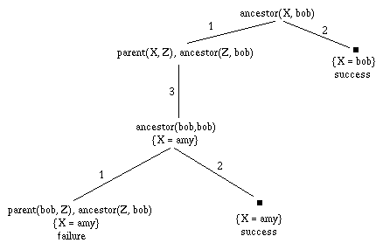
Animation
cut animation.ppt

Slide 51
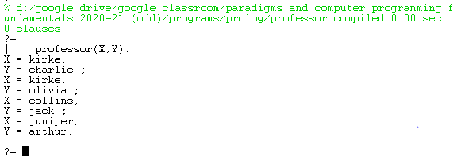
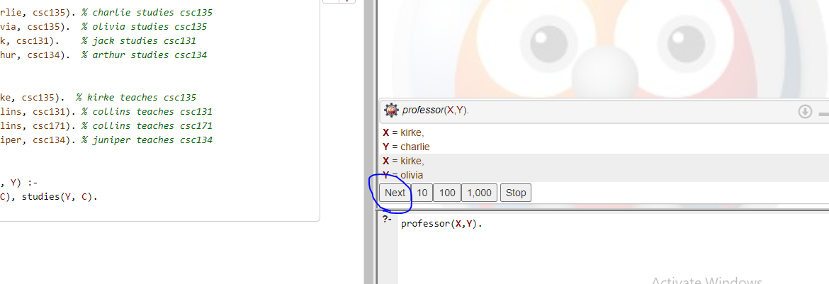
On Swi-Prlog Interpreter (on Desktop) is ; to get the next backtracked solution ( / goal)
On Online Interpreter us Next

Slide 52
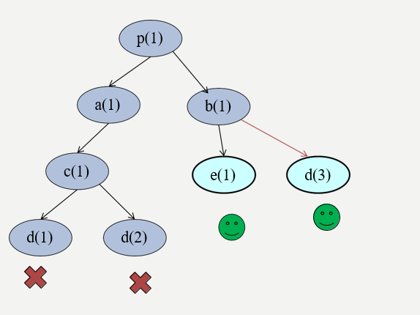
Backtracking can occur at every stage as the query is processed.
p(1) :- a(1).
p(1) :- b(1).
a(1) :- c(1).
c(1) :- d(1).
c(1) :- d(2).
b(1) :- e(1);d(3)
e(1).
d(3).
Query: ?- p(1)
With backtracking we can get more answers by using “;”
DFS

Slide 53
Backtracking is a characteristic feature of Prolog
But backtracking can lead to inefficiency:
Prolog can waste time exploring possibilities that lead nowhere
It would be nice to have some control
The cut predicate ! offers a way to control backtracking
The cut is a Prolog predicate, so we can add it to rules in the body:
– Example:
p(X):- b(X), c(X), !, d(X), e(X). Animation

Slide 54
Example:
father(mary,george).
father(john,george).
father(sue,harry).
father(george,edward).
This works as expected for:
?− father(X, Y ) .
X = mary , Y = george ;
X = john , Y = george ;
X = sue , Y = harry ;
X = george , Y = edward .
However, for this:
?− father ( _ , X ) .
X = george ;
X = george ;
X = harry ;
X = edward .

Slide 55
Example
member(X, [X|T]).
member(X, [H|T]) :- member(X, T).
member may succeed succeed n times
With cut…..
member(X, [X|T]) :- !.
member(X, [H|T]) :- member(X, T).
member may succeed at most one time

Slide 56
Example
max(X,Y,Y):- X =< Y.
max(X,Y,X):- X>Y.
With cut…..
max(X,Y,Y):- X =< Y, !.
max(X,Y,X).

Slide 57
The cut predicate !/0 tells Prolog to discard certain choices of backtracking
It has the effect of pruning branches of the search space.
As an effect,
the programs will run faster
the programs will occupy less memory less memory (less backtracking points to be remembered)

Slide 58
Negation
A logic program contains no negative information, only queries that can be prove nor not.
The Prolog built-in negation corresponds to a query failure: the program cannot prove the query.
The negation symbol is written “\+” or not in older Prolog system
Notes:
http://www.cse.unsw.edu.au/~billw/dictionaries/prolog/negation.html

Slide 59
round(sphere).
?- round(earth).
?- \+ round(earth).

Slide 60
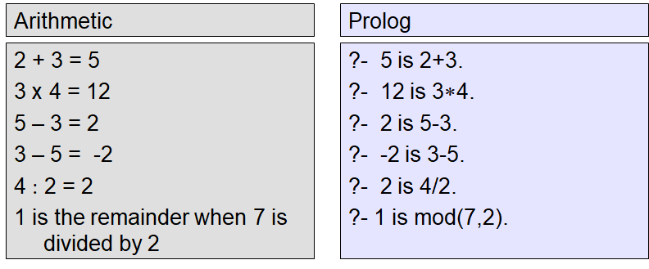
Arithmetic Expressions
•Prolog provides a number of basic arithmetic tools
•Integer and real numbers

Slide 61
'is' is a special functionality used in evaluating arithmetic expressions.
Expression should be on the right side of 'is' otherwise it will give an error.
= checks for unification!
Example: -
?- X is 3+2. // expression on right side of 'is'
X = 5.
?- 3+2 is X. // expression on left side of 'is' ERROR: is/2: Arguments are not sufficiently instantiated

Slide 62
?- X = 3+2. // just instantiate variable X to value 3+2
X = 3+2.
?- 3+2 = X.
X = 3+2.
?- X is +(3,2).
X = 5.
?- 5 is 3+2.
true.

Slide 63
?- 3+2 is 5.
false.
?- X is 3*2.
X = 6.
?- X is 3-2.
X = 1.
?- X is -(2,3).
X = -1.

Slide 64
?- X is 5-3-1.
X = 1.
?- X is -(5,3,1).
ERROR: is/2: Arithmetic: `(-)/3' is not a function
?- X is -(-(5,3),1).
X = 1.
?- X is 5-3-1.
X = 1
?- X is 3/5.
X = 0.6.

Slide 65
?- X is 3 mod 5.
X = 3.
?- X is 5 mod 3.
X = 2.
?- X is 5^3.
X = 125.
?- X is (5^3)^2.
X = 15625.
?- X = (5^3)^2.
X = (5^3)^2.

Slide 66
?- 25 is 5^2.
true.
?- Y is 3+2*4-1.
Y = 10.
?- Y is (3+2)*(4)-(1).
Y = 19.
?- Y is -(*(+(3,2),4),1).
Y = 19.
?- X is 3*2, Y is X*2.
X = 6, Y = 12.

Slide 67
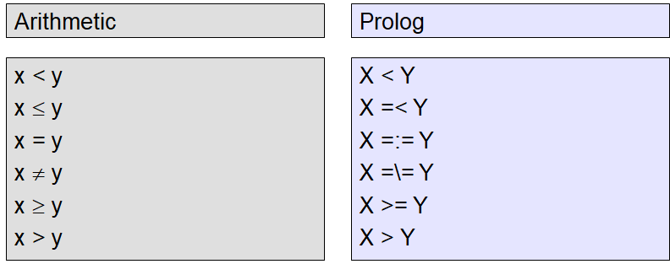
Logical Expressions

Slide 68
Imperative Control Flow
Loops/ Recursion

Slide 69
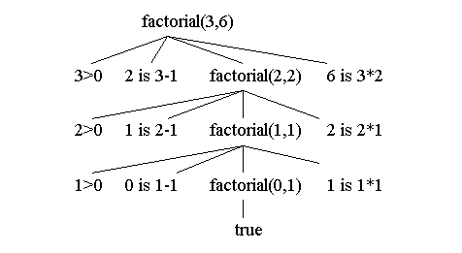
Factorial
factorial(0,1).
factorial(N,F) :-m N>0, N1 is N-1, factorial(N1,F1), F is N * F1.
X

Slide 70
Lists
A list is a finite sequence of elements
Examples of lists in Prolog:
[mia, vincent, jules, yolanda]
[mia, robber(honeybunny), X, 2, mia]
[ ]
[mia, [vincent, jules], [butch, friend(butch)]]
[[ ], dead(z), [2, [b,c]], [ ], Z, [2, [b,c]]]

Slide 71
List elements are enclosed in square brackets
The length of a list is the number of elements it has
All sorts of Prolog terms can be elements of a list
There is a special list:
the empty list [ ]

Slide 72
A non-empty list can be thought of as consisting of two parts
–The head
–The tail
The head is the first item in the list
The tail is everything else
–The tail is the list that remains when we take the first element away
–The tail of a list is always a list

Slide 73
Examples
[mia, vincent, jules, yolanda]
Head: mia
Tail: [vincent, jules, yolanda]
[[ ], dead(z), [2, [b,c]], [ ], Z, [2, [b,c]]]
Head: [ ]
Tail: [dead(z), [2, [b,c]], [ ], Z, [2, [b,c]]]
[dead(z)]
Head: dead(z)
Tail: [ ]

Slide 74
empty list
The empty list has neither a head
nor a tail
For Prolog, [ ] is a special simple list without any internal structure
The empty list plays an important role in recursive predicates for list processing in Prolog

Slide 75
The built-in operator |
Prolog has a special built-in operator | which can be used to decompose a list into its head and tail
The | operator is a key tool for writing Prolog list manipulation predicates
Each list is thus of the form [<head> | <rest_of_list>]

Slide 76
?- [Head|Tail] = [mia, vincent, jules, yolanda].
Head = mia
Tail = [vincent,jules,yolanda]
Yes
?- [X|Y] = [mia, vincent, jules, yolanda].
X = mia
Y = [vincent,jules,yolanda]
Yes
?- [X|Y] = [ ].
no

Slide 77
?- [ _,X2, _,X4|_ ] = [mia, vincent, marsellus, jody, yolanda].
X2 = vincent
X4 = jody
Yes
Some more Examples
Check if an element is there is list or not

Slide 78
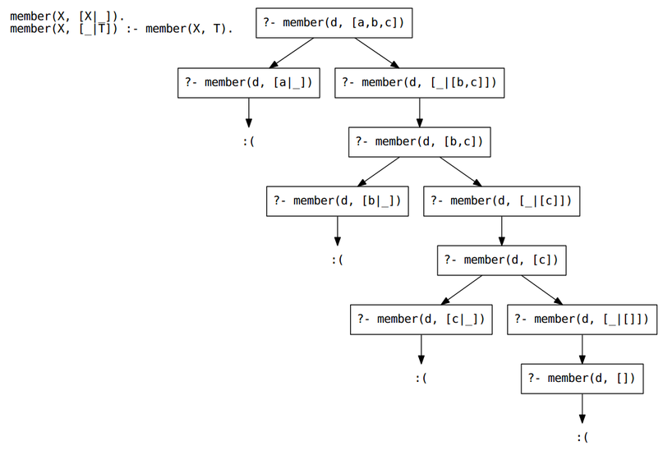
member predicate/functor

Slide 79
Check if the list is sorted
Find the sum of list of elements
With use of accumulators
Append 2 lists
Try: Find the length of list of elements

Slide 80
Also, [a,b,c,d]=[a|[b,c,d]] =[a,b|[c,d]] = [a,b,c|[d]]
List elements can be any term!
[a, f(a), 2, 3+5, point(X,1.5,Z)] contains 5 elements.
List is a structured term
[a | [c | [b | [d | []]]]]
Where [] is a special constant the empty list.

Slide 81
Database manipulation
There are five database manipulation commands that we will using:
assert
-Adds a new fact or clause to the database. Term is asserted as the last fact or clause with the same key predicate.
retract
-Removes fact or clause X from the database.
asserta
- Same as assert, but adds a clause at the beginning of the database
assertz
-Exactly the same as assert(X)
retractall
-Removes all facts or clauses from the database for which the head unifies with X.

Slide 82
start with an empty database
?- listing.
true
?-assert(good(skywalker, luke)).
true
?-assert(good(solo, han)).
true
?-assert(bad(vader, darth)).
true
?- listing(good).
good(skywalker, luke).
good(solo, han).
bad(vader, darth).

Slide 83
?-retract(bad(vader, darth)).
?-retractall(good(_, _)).
?- good(X, Y).
No
Database manipulation is useful when we want to store the results of
Queries, stored to be accessed in future,
we just look up the asserted fact. This technique is called memoization or caching.

Slide 84
Deficiencies of Prolog
Intrinsic Limitations
Prolog is often not efficient
Example:
sorted( [ ] ) .
sorted( [x]) .
sorted([x, y | list]) x <= y, sorted([y | list]).
All permutations of list must be tried until the right one is found.
Closed-world assumption (CWA)
In Prolog, the truths are those that can be proved using its database
If there is insufficient information in the database to prove a query, it is not actually false, it fails

Slide 85
The Negation Problem
Consider the following statement: -
sibling (X, Y) : - parent (M, X) , parent (M, Y) .
a person can be his/her sibling!
Can be solved with a not proposition: -
sibling (X, Y) :- parent (M, X) , parent (M, Y) , not (X = Y) .
However, the not proposition is not a not operator (double negation is not allowed), which causes some limitations

Slide 86
Advantages:
Prolog programs based on logic, so likely to be more logically organized and written
Processine is naturally parallel, so Prolog interpreters can take advantage of multiprocessor machines
Programs are concise, so development time is decreased
good for prototyping

Slide 87
Refernces
Text Book :
1. Scott M L, Programming Language Pragmatics, 3rd Edn., Morgan Kaufmann Publishers, 2009
Chapter 11: Logic Languages (Page no. 545)
Online Resources
http://www.learnprologfalsew.org/lpnpage.php?pageid=online
http://athena.ecs.csus.edu/~mei/logicp/prolog/programming-examples.html
https://www.cpp.edu/~jrfisher/www/prolog_tutorial/2.html

